Slide 1
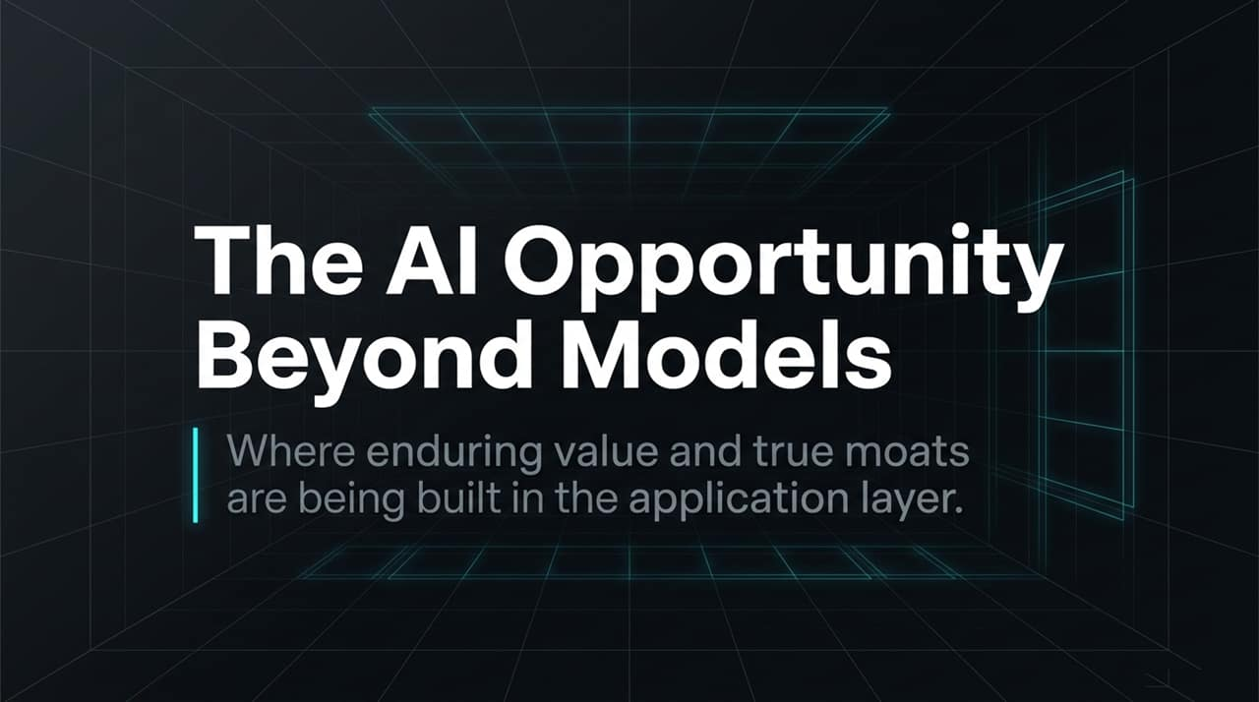
Notes:
https://www.youtube.com/watch?v=3XVDtPU8xKE
Welcome everyone. Today, we are taking a deep dive into where enduring value, real economic moats, and massive enterprise market capitalization are being constructed in the AI era.
While foundational frontier LLMs (OpenAI, Anthropic, Google) receive the vast majority of headlines and initial infrastructure spend, history teaches us that the greatest long-term enterprise value ultimately accrues at the application layer.
Throughout this presentation, we will explore why we are moving past AI as a mere "magic trick" or novel demo and entering an era defined by mission-critical deployment.
We will detail the 3 Strategic Pillars driving the application explosion: AI-Native SaaS, Software Eating Labor, and Walled Garden Data Models.

Slide 2
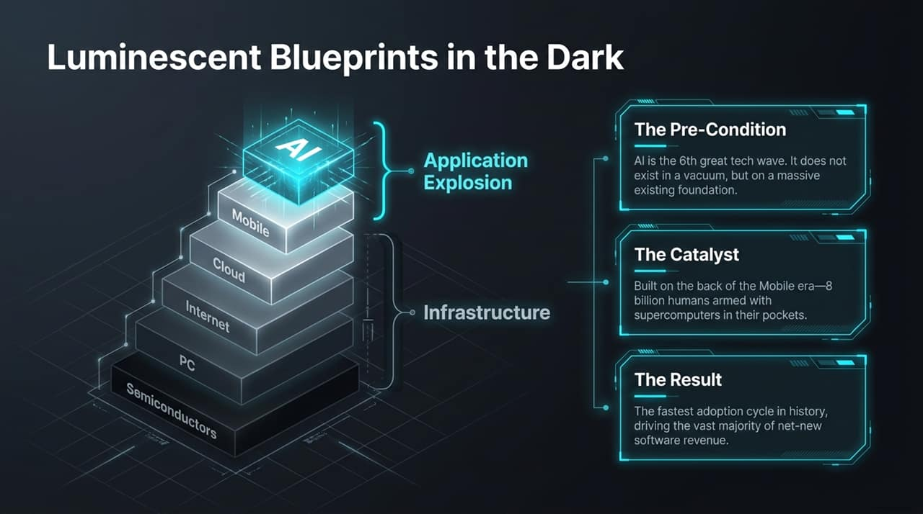
Notes:
To understand why AI applications are scaling at an unprecedented rate, we must look at the broad history of technology product cycles. AI is the 6th great wave of computing, following Semiconductors, PCs, the Internet, Cloud, and Mobile.
Crucial Context: AI did not emerge in a vacuum. It is accelerating exponentially because it sits directly on top of the massive digital infrastructure built over the last 30 years.
The Catalyst: The Mobile and Cloud eras distributed over 8 billion supercomputers directly into human hands. If AI were invented in 1946 with the ENIAC, it would be a museum curiosity; today, it reaches billions instantaneously.
The Result: We are observing the fastest software adoption cycle in human history. AI applications are capturing the vast majority of net-new software revenue.

Slide 3
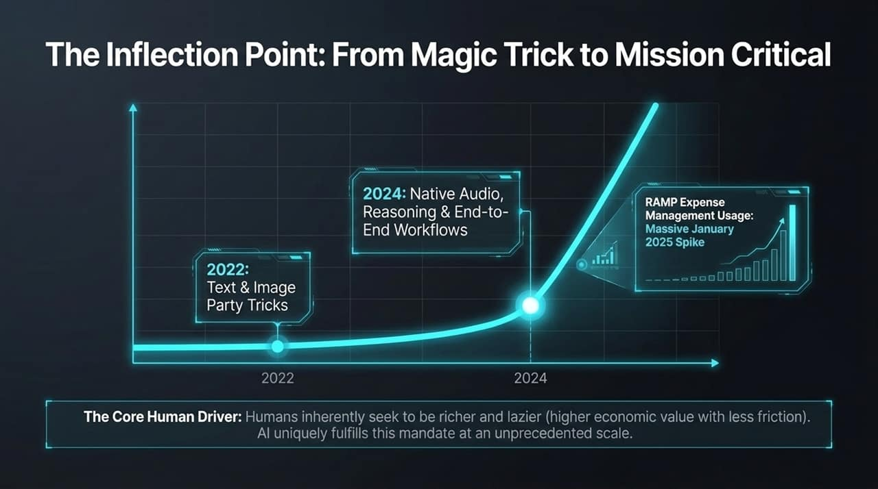
Notes:
Let's analyze how enterprise perception of AI has shifted from late 2022 to today.
2022–2023 ("Party Tricks"): AI models like GPT-3.5 and early diffusion engines were impressive novelties. Users drafted Seinfeld scripts or generated images—fun magic tricks, but not core line-of-business software.
2024–2026 ("Mission Critical"): With native multimodal audio, complex reasoning chains, and agentic workflows, AI has become essential infrastructure.
Data Evidence: Look at the corporate expense usage data from Ramp. Early 2025 marks a sharp, permanent vertical spike in enterprise AI adoption. Mid-market and forward-thinking enterprises moved past pilot phases directly into production spending.
The Core Human Driver: All human adoption boils down to a single principle: Humans inherently seek to be richer and lazier—achieving higher economic value with dramatically lower friction. AI fulfills this fundamental mandate better than any prior technology.

Slide 4
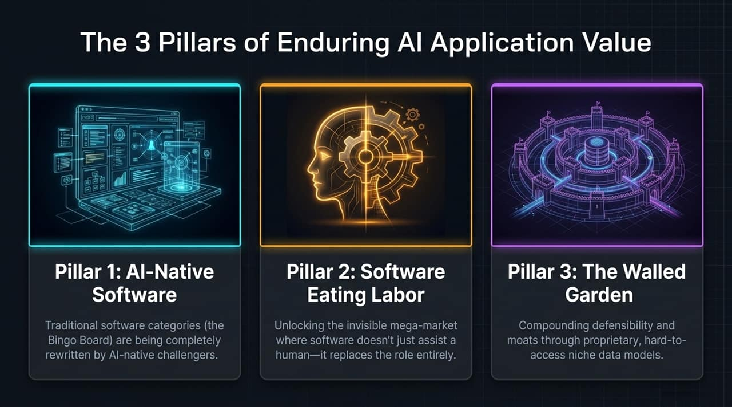
Notes:
As venture investors evaluating where defensibility lies against frontier model encroachment, we focus on three core pillars:
Pillar 1: Existing Categories Going AI-Native: Complete rewrite of traditional SaaS vertical and enterprise "Bingo Boards" (ERP, CRM, HR, Support).
Pillar 2: Software Eating Labor: Shifting focus from selling internal workflow tools for human workers to selling automated software that completes the full job itself. This opens access to the global labor market.
Pillar 3: The Walled Garden: Building defensible competitive moats using hard-to-access, proprietary data assets that base LLMs cannot scrape or train on.

Slide 5
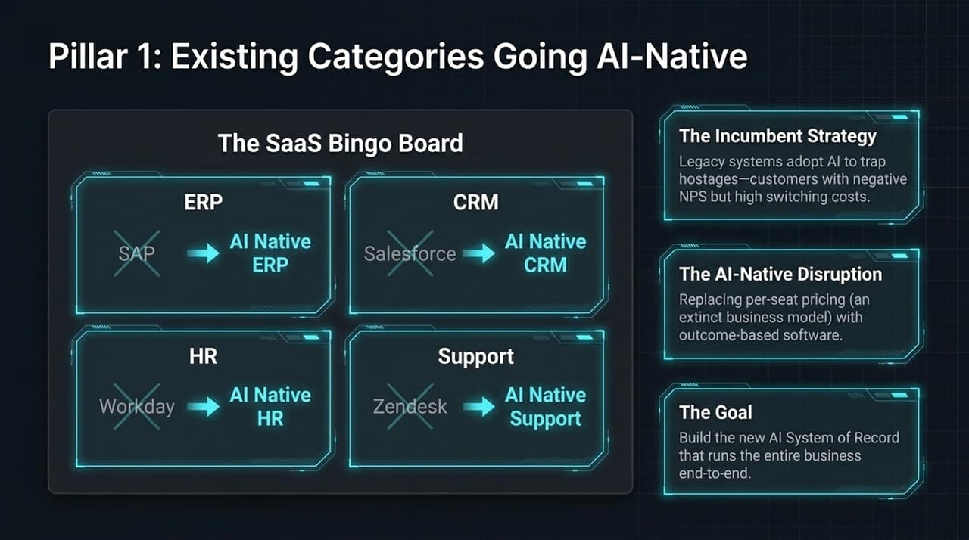
Notes:
Let's look at the classic SaaS "Bingo Board". Every major incumbent software category—SAP for ERP, Salesforce for CRM, Workday for HR, Zendesk for Support—is being challenged by AI-native platforms.
Incumbent Strategy: Legacy vendors are adding thin AI features to hold their customers "hostage". The best incumbent businesses have high switching costs rather than high NPS, allowing them to bolt on AI surcharges.
AI-Native Disruption: Challengers are abandoning obsolete per-seat pricing models. When an AI support bot handles 99% of inquiries, selling seat licenses makes no economic sense. Instead, AI-native platforms charge per completed outcome or resolution.
The Goal: Build the definitive, end-to-end AI System of Record that manages the business context natively.

Slide 6
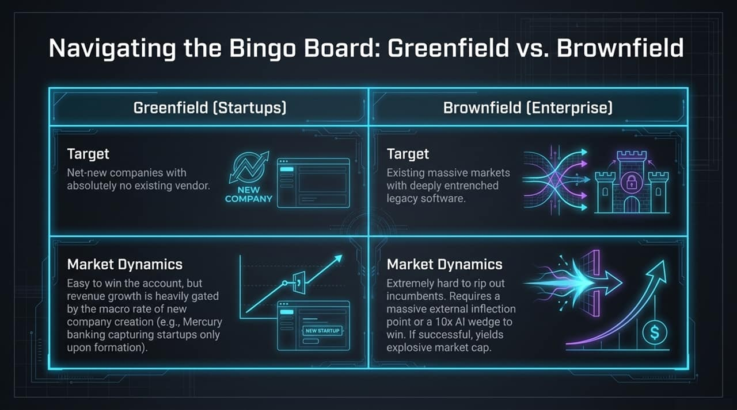
Notes:
Disruption strategy on the SaaS Bingo Board requires distinguishing between Greenfield and Brownfield opportunities.
Greenfield (Startups): Targets net-new companies with zero pre-existing vendor lock-in.
Dynamics: Extremely easy customer acquisition because there is no legacy system to rip out. However, revenue growth is strictly bounded by macro startup creation rates.
Brownfield (Enterprise): Targets established markets dominated by legacy software like NetSuite or SAP.
Dynamics: Hard to replace entrenched incumbents unless you hit a sharp customer inflection point (e.g., expanding from single to multi-entity/multi-currency operations) or offer a 10x AI wedge. Winning a Brownfield account unlocks massive market capitalization.

Slide 7
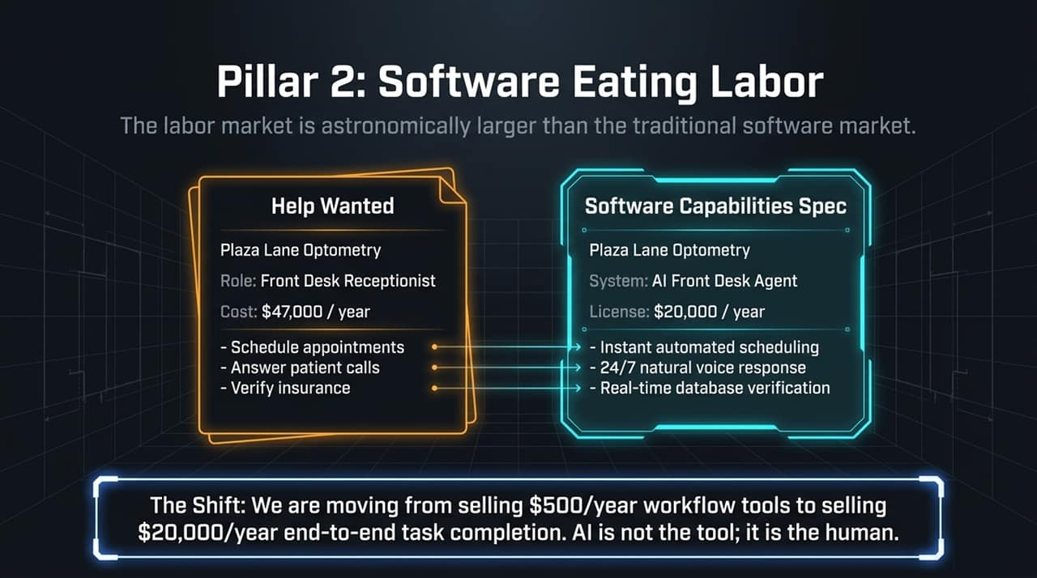
Notes:
Moving to Pillar 2: The global labor budget is orders of magnitude larger than the global IT software budget.
Consider an optometry practice hiring a front-desk receptionist:
Human Worker: $47,000/year to answer phones, schedule appointments, and verify insurance.
AI Front Desk Agent: $20,000/year license fee providing 24/7 natural voice response, instantaneous scheduling, and real-time database checks.
The Paradigm Shift: We are transitioning from selling $500/year seat-based productivity widgets to selling $20,000/year digital workers that complete tasks end-to-end. AI is no longer just the tool; AI is becoming the workforce.

Slide 8
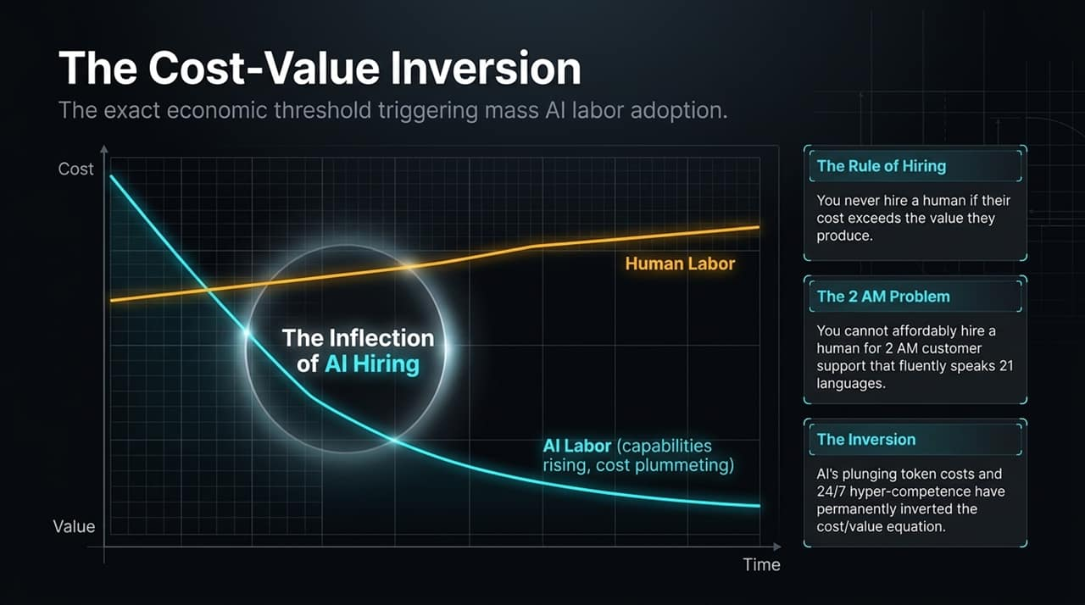
Notes:
What is the economic threshold driving this rapid transition to digital labor?
The Rule of Hiring: An organization never hires a human worker if their total compensation exceeds the economic value they generate.
The 2 AM Problem: You cannot economically hire human staff to handle late-night customer support across 21 languages for edge-case queries—the cost vastly exceeds the marginal value.
The Inversion Point: As inference token costs collapse while reasoning capabilities improve, the AI cost/value dynamic permanently inverts. Organizations can now deploy hyper-competent AI labor for tasks that were previously cost-prohibitive.

Slide 9
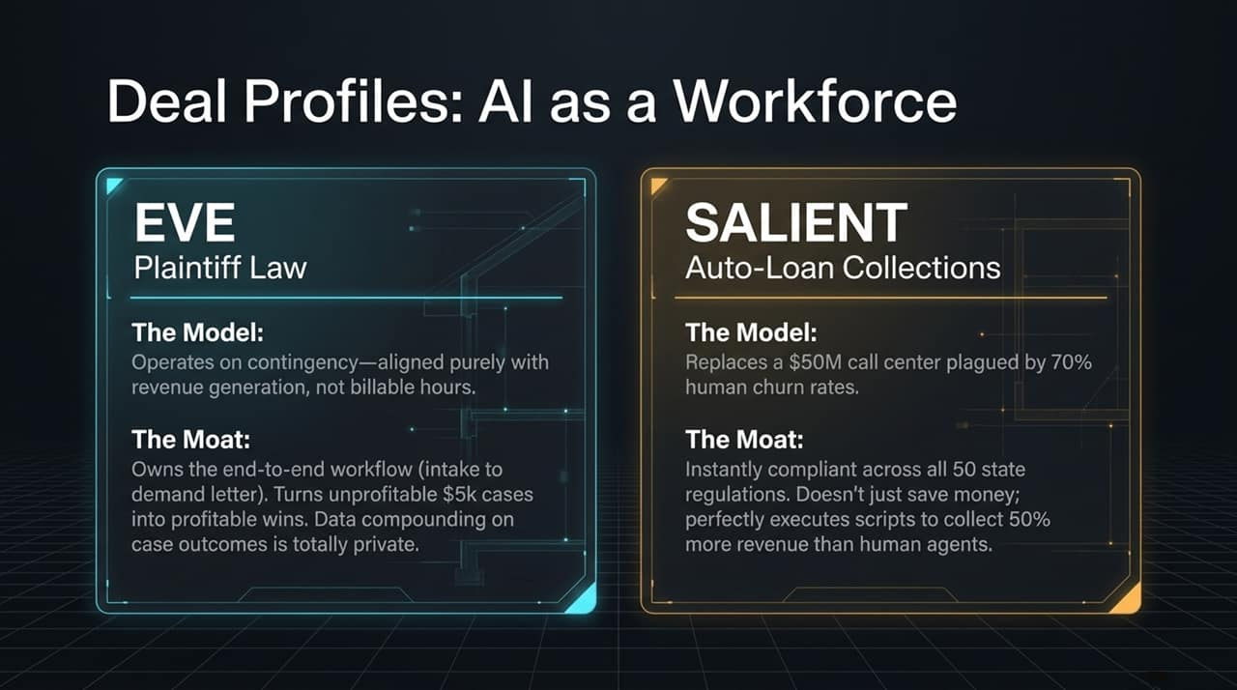
Notes:
Let's look at two specific case studies: EVE and SALIENT.
EVE (Plaintiff Legal AI):
Business Model: Contingency-aligned. Unlike hourly corporate law firms, plaintiff lawyers only get paid if they win.
Moat: EVE handles end-to-end workflows from intake voice calls to drafting medical chronologies and demand letters. By reducing administrative friction, EVE allows law firms to turn previously unprofitable $5k cases into high-margin wins.
SALIENT (Auto-Loan Collections):
Business Model: Replaces $50M call centers suffering from 70% annual employee turnover.
Moat: Guarantees real-time regulatory compliance across all 50 states. SALIENT doesn't just save money; its optimized AI scripts yield 50% higher debt recovery rates than human call center agents.

Slide 10
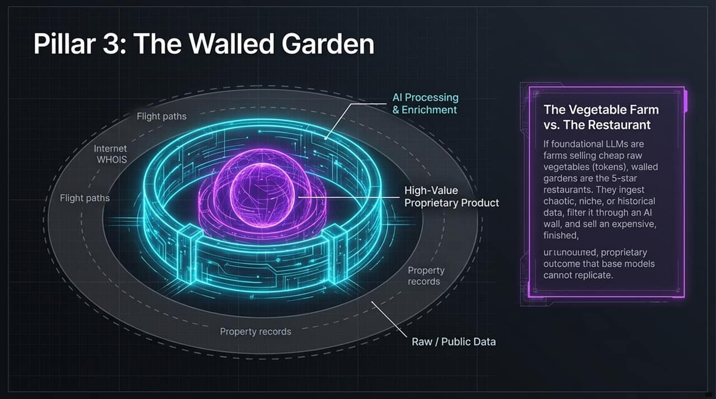
Notes:
Pillar 3 focuses on defensibility in an environment where base LLMs are becoming commoditized.
The Metaphor: Vegetable Farm vs. 5-Star Restaurant:
Foundational model providers (OpenAI, Anthropic) operate like vegetable farms selling raw ingredients (tokens) at declining margins.
Walled Gardens operate as 5-star restaurants. They gather unstructured, niche, public, or proprietary data assets (FlightAware paths, domain WHOIS records, property filings), process them through AI layers, and sell high-value finished outcomes.
Base foundation models cannot replicate these outcomes because they lack access to the underlying underlying data vaults.

Slide 11
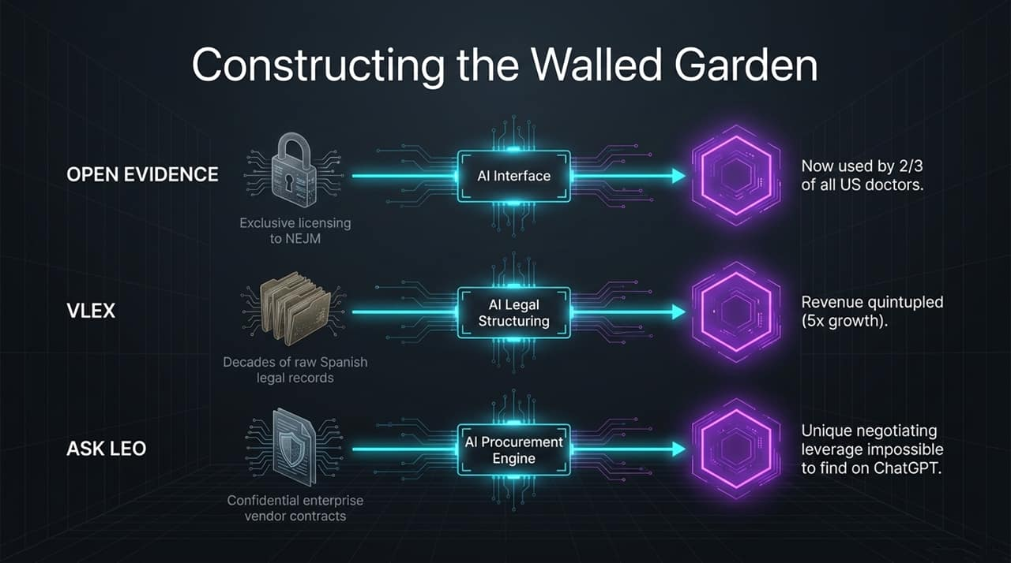
Notes:
Here are three real-world examples of Walled Garden architectures:
Open Evidence: Secured exclusive licensing to the New England Journal of Medicine and premier medical literature. Today, two-thirds of US doctors use it weekly because general LLMs do not possess its verified evidence-based medical dataset.
VLEX: Digitized decades of unindexed legal records across Spain and international jurisdictions. By integrating an AI reasoning interface over this exclusive legal corpus, VLEX quintupled its annual revenue.
Ask Leo: Ingests confidential enterprise vendor and procurement contracts. It provides contract negotiation leverage that general public models cannot match.

Slide 12
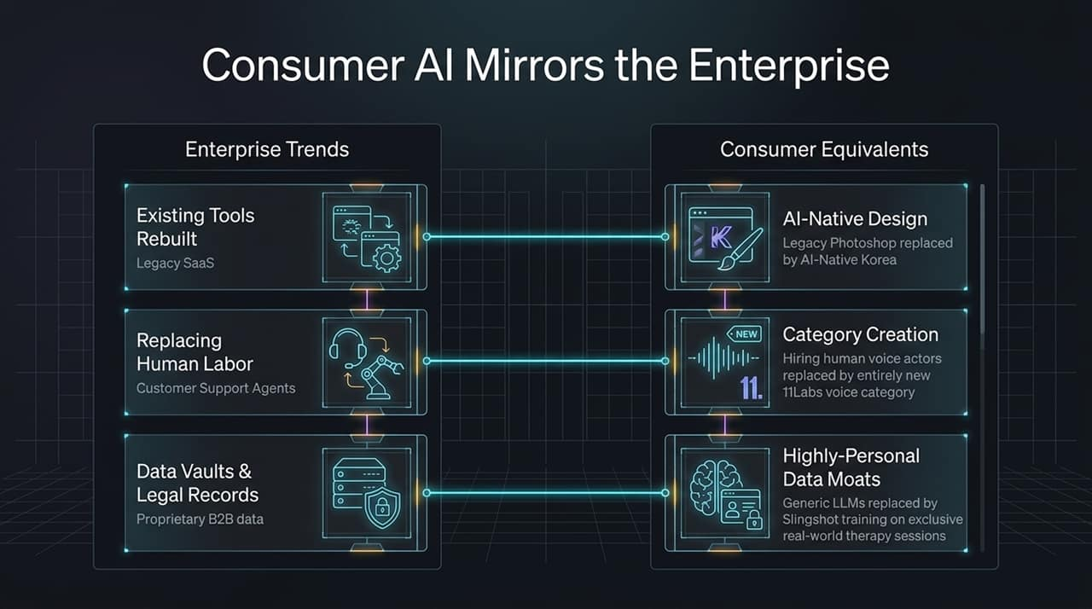
Notes:
As Anish Acharya highlights, consumer AI adoption directly parallels the structural patterns seen in enterprise software.
Existing Tools Rebuilt: Legacy design software like Photoshop is being bypassed by digital natives in favor of AI-first suites like Korea.
Labor Replacement & Category Creation: Instead of hiring human voice actors, creators rely on ElevenLabs, establishing a voice and audio synthesis category.
Proprietary Data Moats: Slingshot (Ash) deploys AI scribes alongside licensed human therapists during real sessions. They use these confidential notes to fine-tune specialized therapy models, creating a consumer moat that generic LLMs cannot easily replicate.

Slide 13
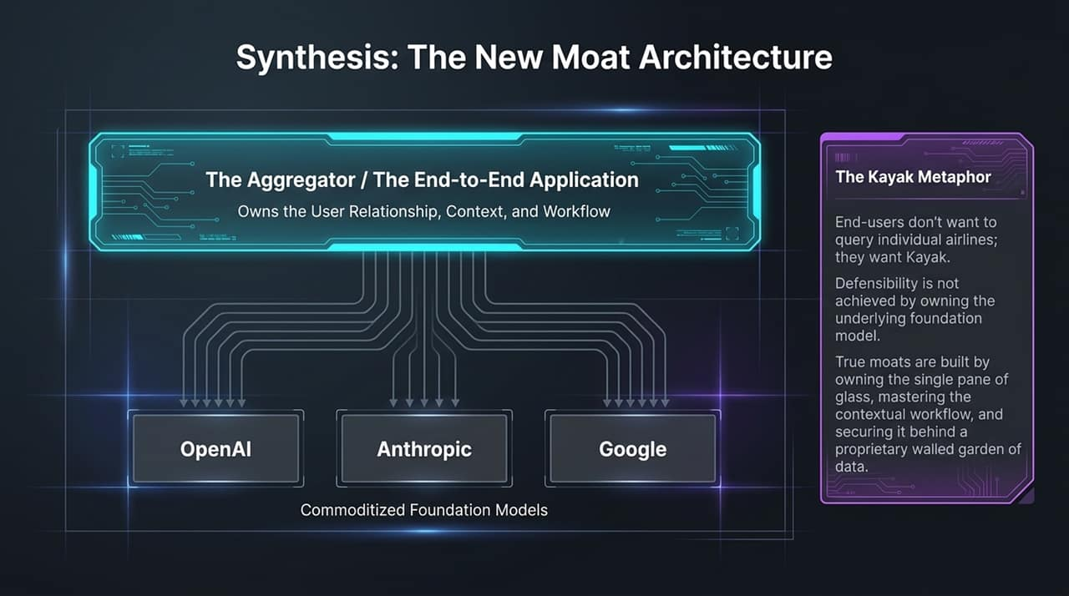
Notes:
How do we summarize long-term software defensibility in the AI era?
The Kayak Metaphor: Travelers do not visit individual airline sites directly; they go to Kayak to search across all options. Similarly, users often want a single pane of glass aggregating specialized models rather than relying on a single frontier model provider.
Where Moats live: Defensibility is not created by owning an underlying foundation model, as those are increasingly commoditized.
True, enduring moats are built by owning the user relationship, mastering the end-to-end contextual workflow, and securing proprietary data inside a walled garden.

Slide 14
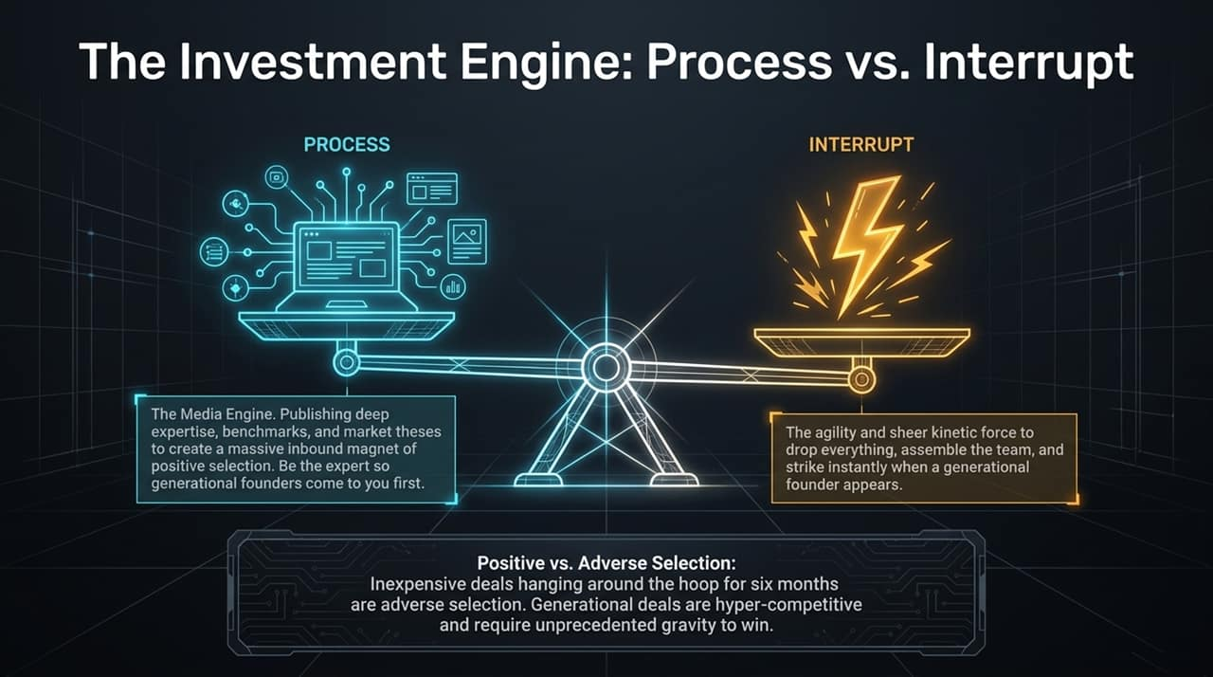
Notes:
To capture high-value application platforms, venture firms must align their operational cadence with two operational modes: Process vs. Interrupt.
Process (The Media Engine): Consistently publishing market theses, deep technical benchmarks, and domain research. This establishes market expertise and attracts positive inbound founder selection.
Interrupt (Kinetic Execution): The organizational agility to drop everything instantly when a generational founder emerges.
Selection Dynamics: Deals lingering on the market for 6 months represent adverse selection. Generational opportunities move quickly and require clear domain authority to win.

Slide 15
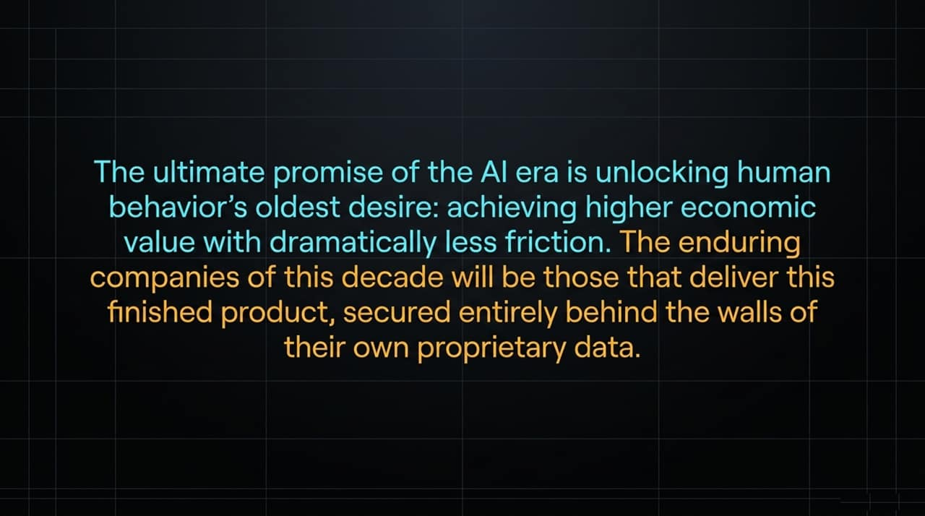
Notes:
To conclude: The ultimate promise of the AI era is unlocking the oldest driver of human economic activity—achieving higher economic value with lower operational friction.
The category-defining platforms of this decade will not merely provide raw AI capabilities. They will deliver finished, end-to-end business outcomes, embedded deeply inside daily user workflows, and secured behind proprietary data walls.

Slide 16
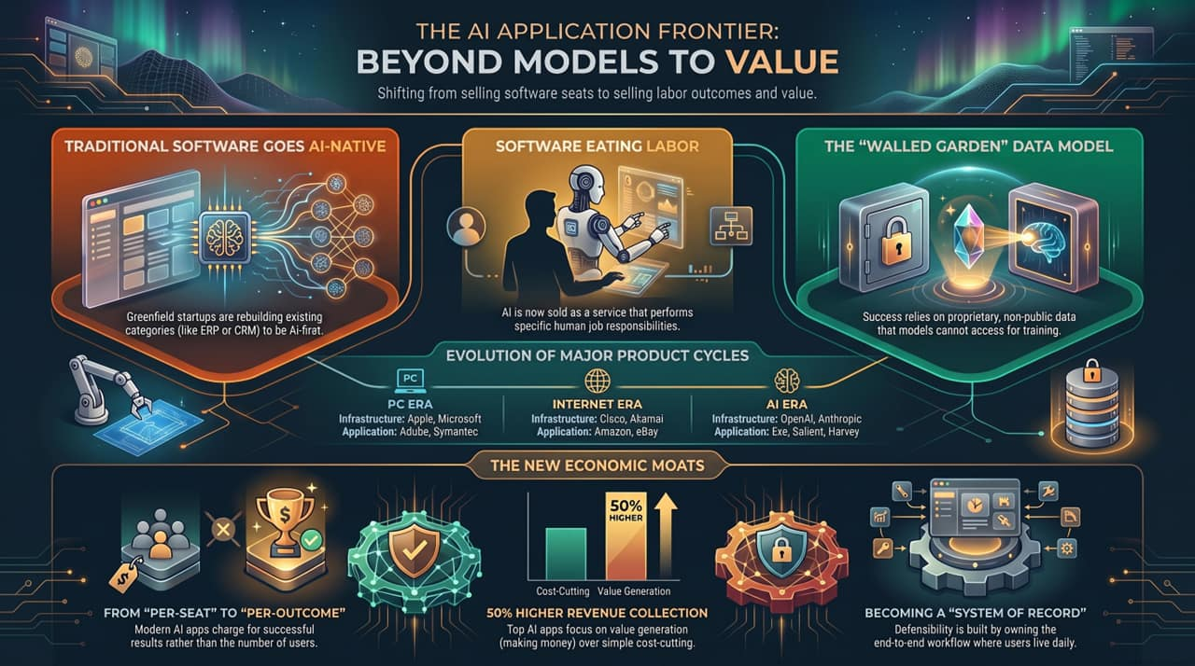
Notes:
This executive summary slide maps the core transformations discussed throughout the presentation:
Evolution of Product Cycles: PC $\rightarrow$ Internet $\rightarrow$ Cloud/Mobile $\rightarrow$ AI Application Layer.
Business Model Shift: Transitioning from static "Per-Seat" SaaS subscriptions to value-aligned "Per-Outcome" pricing models.
Labor Expansion: Moving beyond basic workflow assistance to full end-to-end task completion.
Value Focus: Prioritizing top-line revenue generation (e.g., 50% higher debt recovery) over basic cost reduction.

